Slide 1
Fitting models to experiments
Optical Tweezers Summer School
Santiago, Chile
11.-15. December 2024
Are Mjaavatten

Slide 2
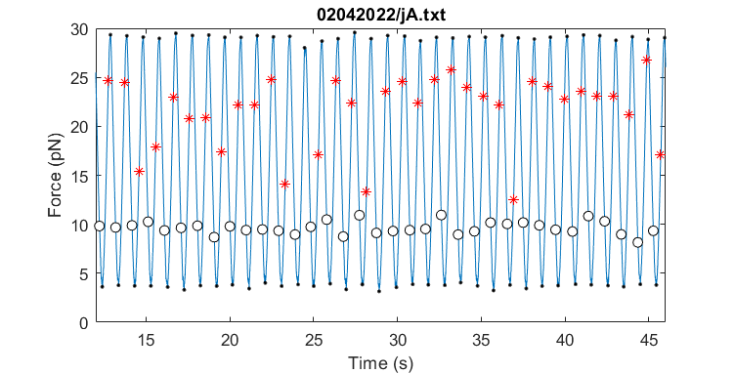
Rip force is not the same for all experiments

Slide 3
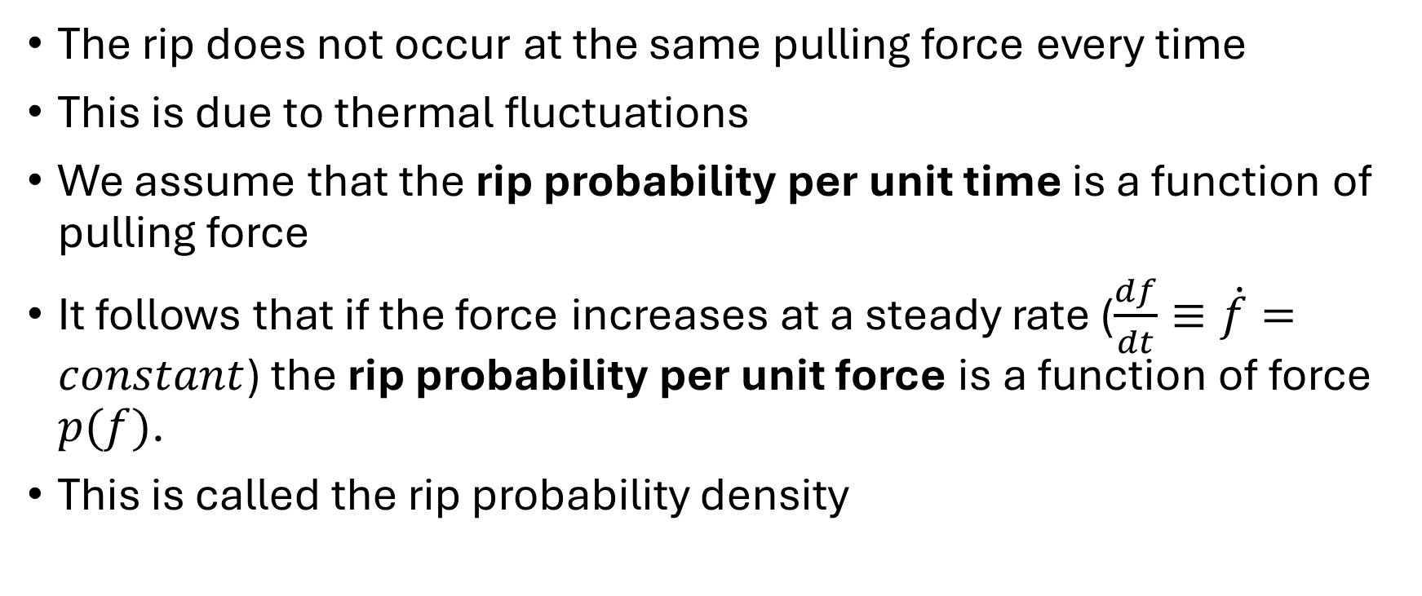
Rip and zip probability
The rip does not occur at the same pulling force every time
This is due to thermal fluctuations
We assume that the rip probability per unit time is a function of pulling force
It follows that if the force increases at a steady rate ($\frac{df}{dt}≡\dot{f}=constant$) the rip probability per unit force is a function of force $p(f)$.
This is called the rip probability density

Slide 4
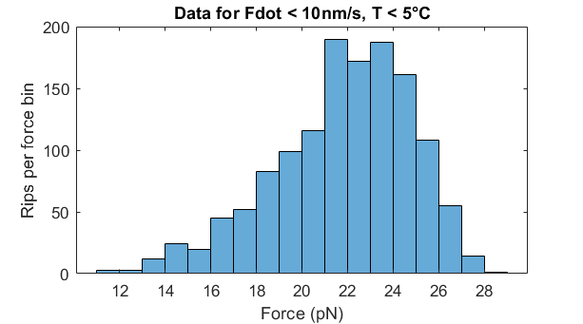
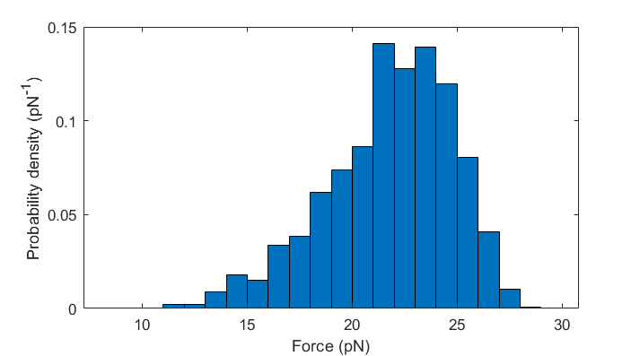
Experimental rip/zip probability estimates per unit force
If we have recorded the rip force for many events, we can count the number of rips inside force intervals (force bins) and create a histogram.
Dividing the number in each bin by the total number of rips and the bin width we get an estimate of the probability density
The models take this density as input

Slide 5
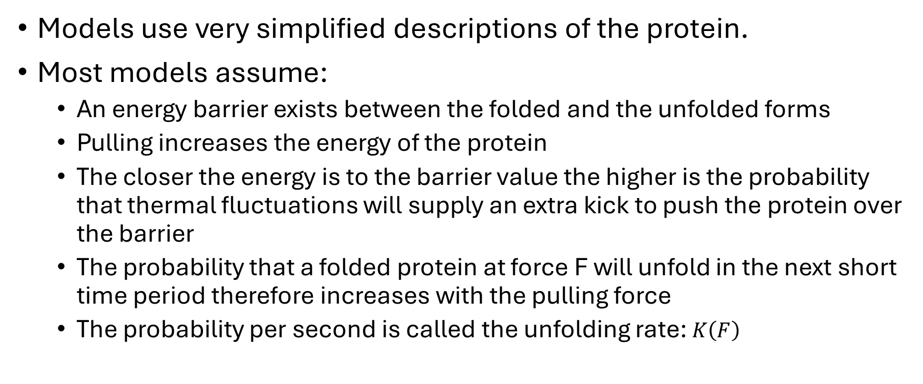
Modelling of protein unfolding
Models use very simplified descriptions of the protein.
Most models assume:
An energy barrier exists between the folded and the unfolded forms
Pulling increases the energy of the protein
The closer the energy is to the barrier value the higher is the probability that thermal fluctuations will supply an extra kick to push the protein over the barrier
The probability that a folded protein at force F will unfold in the next short time period therefore increases with the pulling force
The probability per second is called the unfolding rate: $K\left(F\right)$

Slide 6
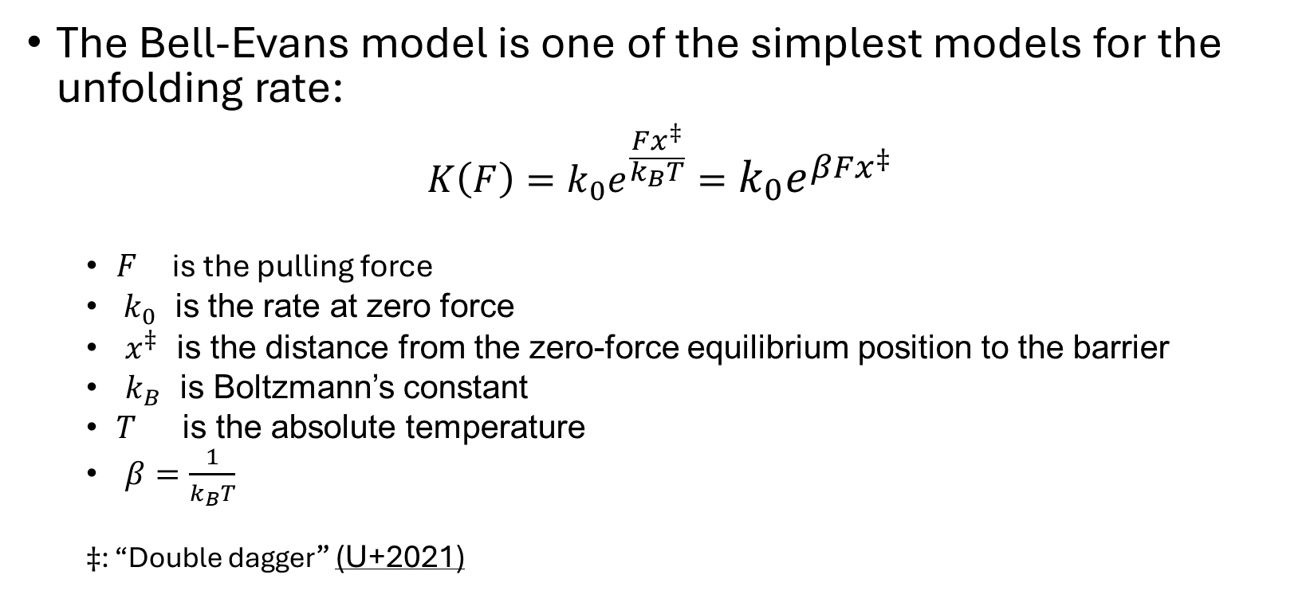
Bell-Evans model
The Bell-Evans model is one of the simplest models for the unfolding rate:
$$K\left(F\right)=k_{0}e^{\frac{Fx^{‡}}{k_{B}T}}=k_{0}e^{βFx^{‡}}$$
$F$ is the pulling force
$k_{0}$ is the rate at zero force
$x^{‡}$ is the distance from the zero-force equilibrium position to the barrier
$k_{B}$ is Boltzmann’s constant
$T$ is the absolute temperature
$β=\frac{1}{k_{B}T}$
$‡$: “Double dagger” (U+2021)
Evans & Ritchie, Biophys J. 72 (1997)

Slide 7
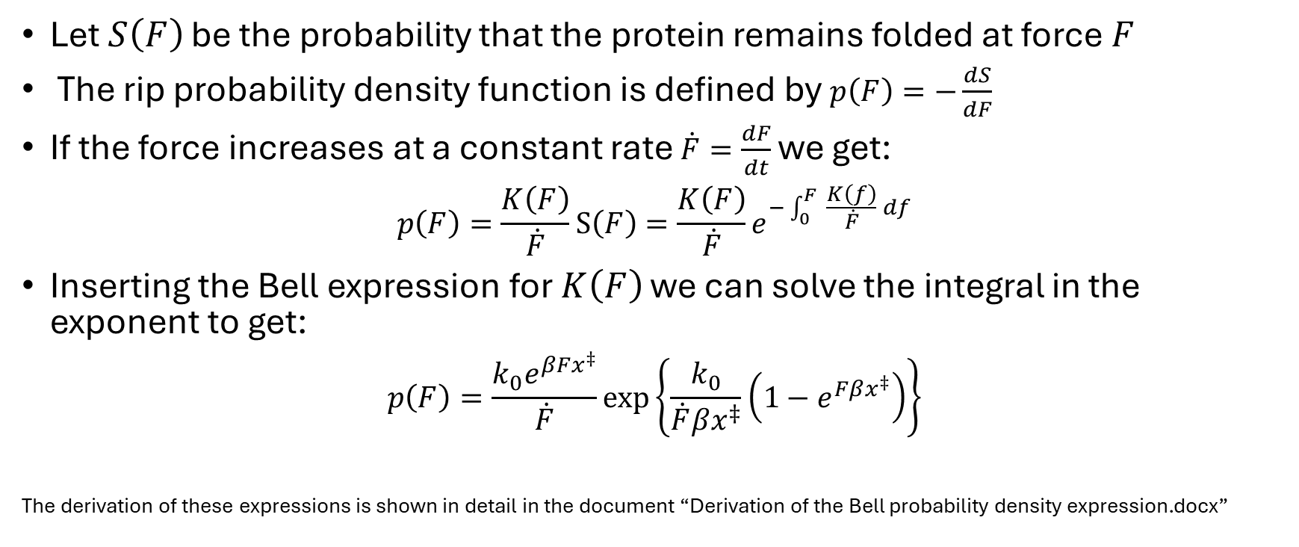
Rip probability density function
Let $S\left(F\right)$ be the probability that the protein remains folded at force $F$
The rip probability density function is defined by $p\left(F\right)=−\frac{dS}{dF}$
If the force increases at a constant rate $\dot{F}=\frac{dF}{dt}$ we get:
$$p\left(F\right)=\frac{K\left(F\right)}{\dot{F}}S\left(F\right)=\frac{K\left(F\right)}{\dot{F}}e^{−\int_{0}^{F}{ \frac{K\left(f\right)}{\dot{F}} df}}$$
Inserting the Bell expression for $K\left(F\right)$ we can solve the integral in the exponent to get:
$$p\left(F\right)=\frac{k_{0}e^{βFx^{‡}}}{\dot{F}}exp\left\{\frac{k_{0}}{\dot{F}βx^{‡}}\left(1−e^{Fβx^{‡}}\right)\right\}$$
The derivation of these expressions is shown in detail in the document “Derivation of the Bell probability density expression.docx”

Slide 8
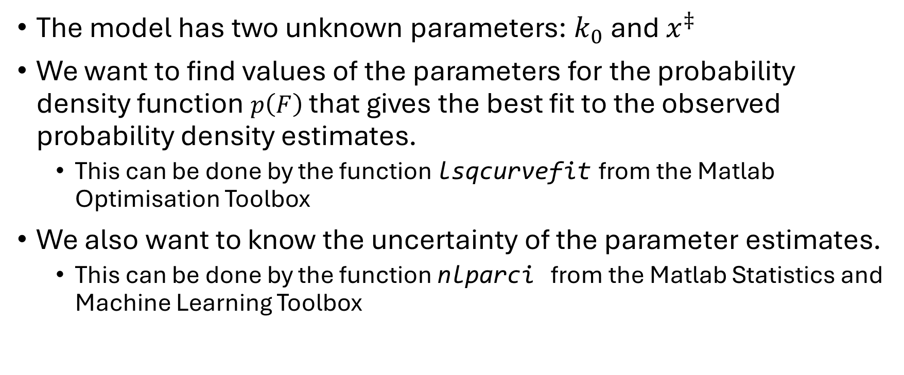
Fitting the Bell-Evans model to experiments
The model has two unknown parameters: $k_{0}$ and $x^{‡}$
We want to find values of the parameters for the probability density function $p\left(F\right)$that gives the best fit to the observed probability density estimates.
This can be done by the function lsqcurvefit from the Matlab Optimisation Toolbox
We also want to know the uncertainty of the parameter estimates.
This can be done by the function nlparci from the Matlab Statistics and Machine Learning Toolbox
lsqcurvefit: Solve nonlinear curve-fitting (data-fitting) problems in the least-squares sense
nlparci: Nonlinear regression parameter confidence intervals

Slide 9
Zero force unfolding rate k₀
The protein we study is quite stable
This means that k₀ has a very low value
When we try to estimate this value directly, nlparci tends to give confidence intervals that include negative values.
Negative values of k₀ do not make sense
So instead, we try to fit the base 10 logarithm of k₀: log10(k₀).
This is more well-behaved and gives reasonable (but sometimes wide) confidence intervals.

Slide 10
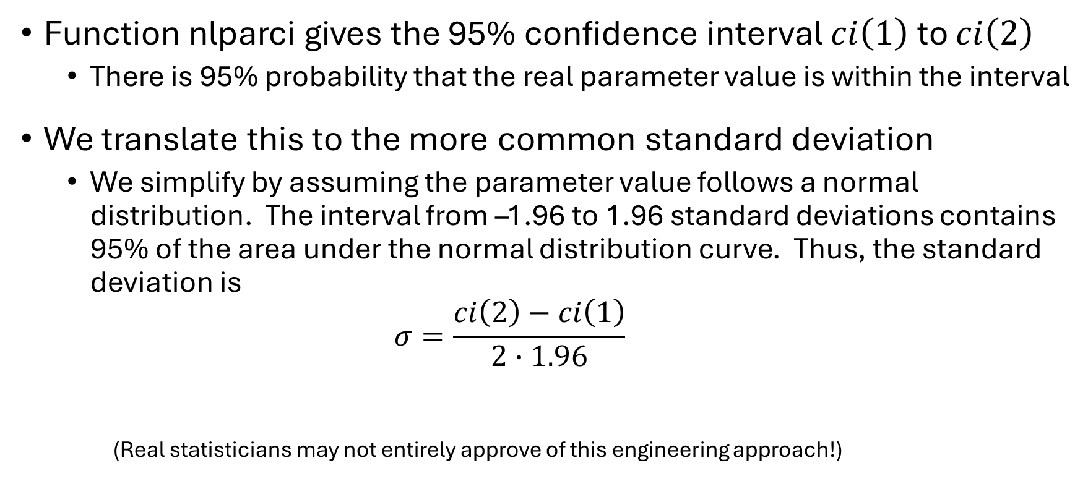
Confidence interval and standard deviation
Function nlparci gives the 95% confidence interval $ci\left(1\right)$ to $ci\left(2\right)$
There is 95% probability that the real parameter value is within the interval
We translate this to the more common standard deviation
We simplify by assuming the parameter value follows a normal distribution. The interval from –1.96 to 1.96 standard deviations contains 95% of the area under the normal distribution curve. Thus, the standard deviation is $σ=\frac{ci\left(2\right)−ci\left(1\right)}{2∙1.96}$
(Real statisticians may not entirely approve of this engineering approach!)

Slide 11
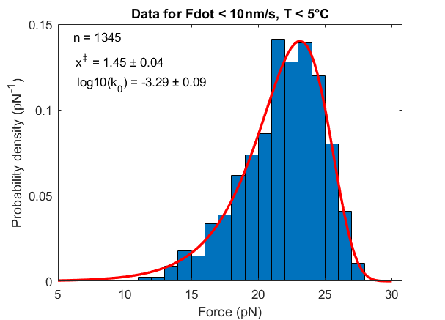
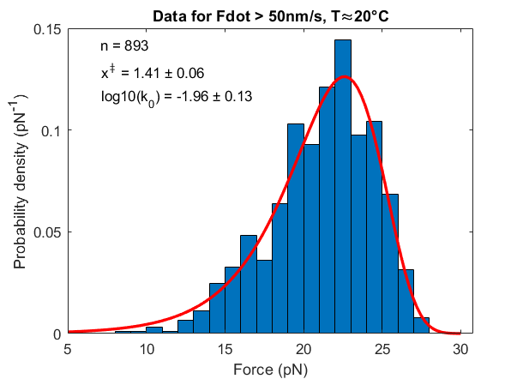
Fitting results
Data for 3588 rip events from 32 experiments on the protein MJ0366.
Ref: Rivera, Mjaavatten, Smith, Baez, & Wilson (2023). Biophysical Journal, 122(3), 513-521.

Slide 12
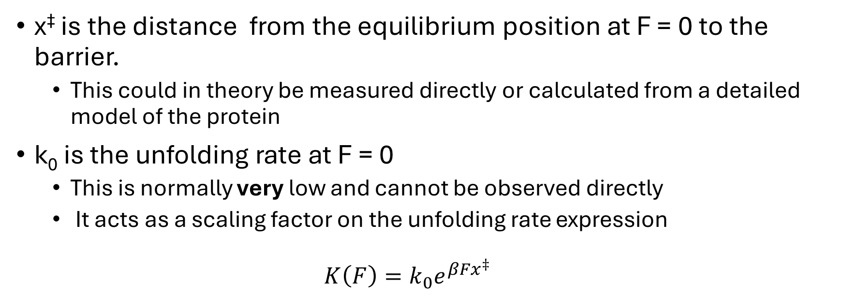
What do the parameters mean?
x‡ is the distance from the equilibrium position at F = 0 to the barrier.
This could in theory be measured directly or calculated from a detailed model of the protein
k₀ is the unfolding rate at F = 0
This is normally very low and cannot be observed directly
It acts as a scaling factor on the unfolding rate expression
$$K\left(F\right)=k_{0}e^{βFx^{‡}}$$
Protein pulling experiments are a simple(?) way of observing these properties

Slide 13
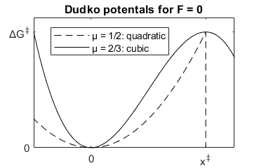
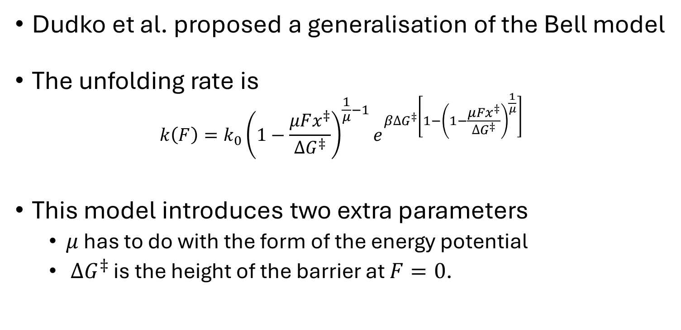
The Dudko model
Dudko et al. proposed a generalisation of the Bell model
The unfolding rate is $k\left(F\right)=k_{0}{\left(1−\frac{μFx^{‡}}{∆G^{‡}}\right)}^{\frac{1}{μ}−1}e^{β∆G^{‡}\left[1−{\left(1−\frac{μFx^{‡}}{∆G^{‡}}\right)}^{\frac{1}{μ}}\right]}$
This model introduces two extra parameters
$μ$ has to do with the form of the energy potential
$∆G^{‡}$ is the height of the barrier at $F=0$.
Dudko, Hammer and Szabo (Phys. Rev. Lett. 96. 2006)

Slide 14
Over-parameterization
There is a limit to how many parameters you can meaningfully determine from your data.
With four parameters I can fit an elephant, and with five I can make him wiggle his trunk.
John Von Neumann (1903-1957)
American mathematician, physicist and computer scientist
It is a paradox that artificial intelligence models may use billions of parameters!

Slide 15
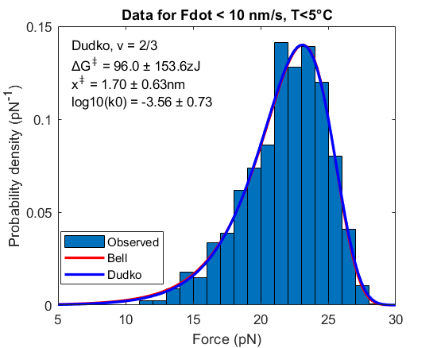
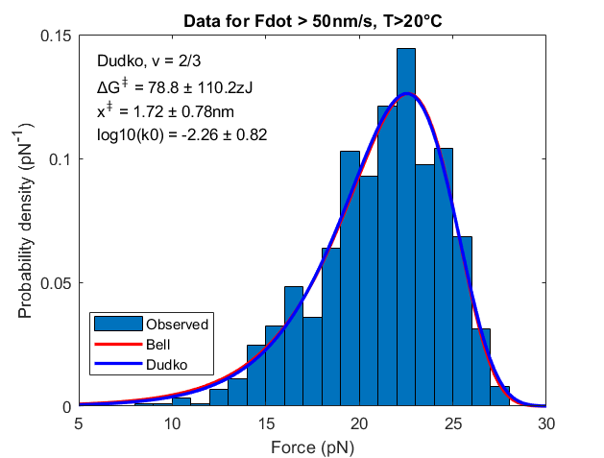
In this case the two models are equally good

Slide 16
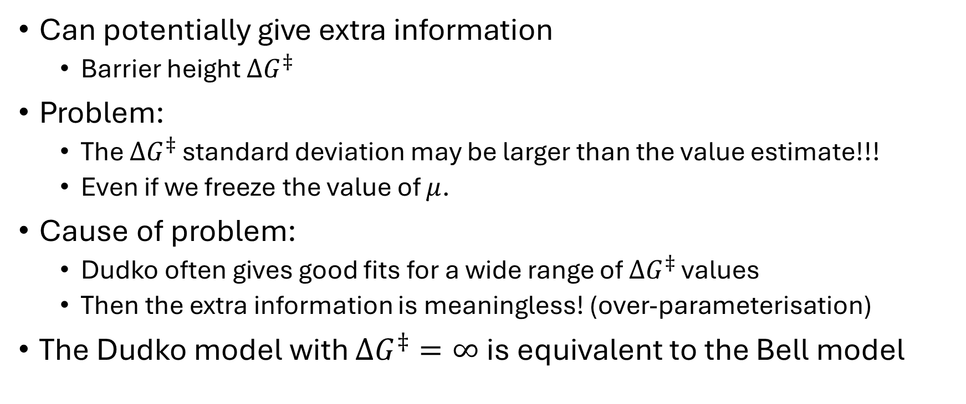
Why use the Dudko model?
Can potentially give extra information
Barrier height $∆G^{‡}$
Problem:
The $∆G^{‡}$ standard deviation may be larger than the value estimate!!!
Even if we freeze the value of $μ$.
Cause of problem:
Dudko often gives good fits for a wide range of $∆G^{‡}$ values
Then the extra information is meaningless! (over-parameterisation)
The Dudko model with $∆G^{‡}=∞$ is equivalent to the Bell model

Slide 17
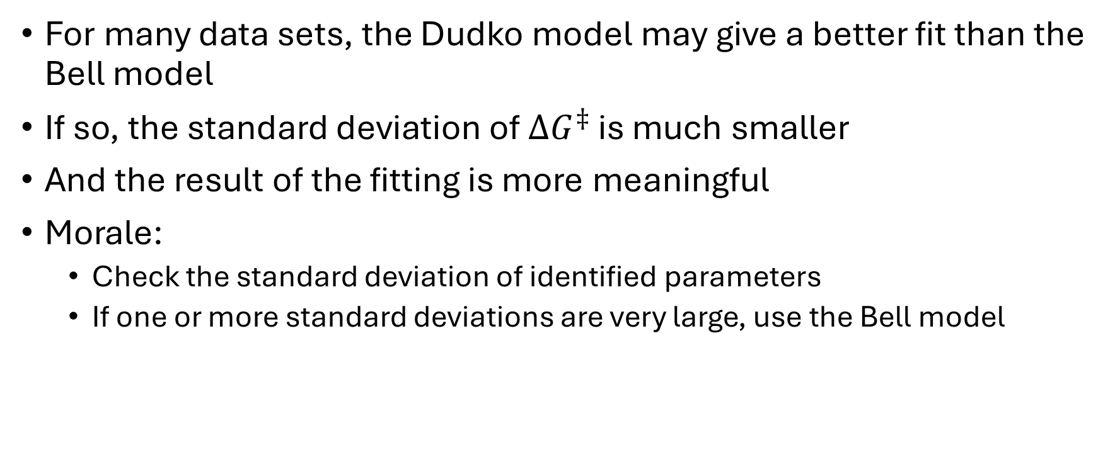
When is the Dudko model relevant?
For many data sets, the Dudko model may give a better fit than the Bell model
If so, the standard deviation of $∆G^{‡}$ is much smaller
And the result of the fitting is more meaningful
Morale:
Check the standard deviation of identified parameters
If one or more standard deviations are very large, use the Bell model

Slide 18
Model fitting workflow
Collect all analysis result tables into TRIP and TZIP
Select the subset you want to model (e.g. Temperature > 20)
Prepare the input to fit_Bell_unfold.m
Define initial values for the parameter vector
Calculate best fit parameters for the Bell (or Dudko) model
Check that results look ok
If not, try with other initial values
I use the files in Summer School/Testfiles.zip as an example

Slide 19
Collect analysis result tables
Make a list of all results files for your protein
Regardless of temperature, pulling speed or whatever
You can easily extract subsets later
Aid to creating the file list:
Collect all experiment subfolders in a string array:
folders = ["subfolder1","subfolder2","subfolder3"];
Create array of experiment file names:
files = experiment_filenames(folders);
Requires that you have created datafolder.m

Slide 20
Collect analysis result tables (2)
If you have not used the RipAnalysis app to modify results:
[TRIP,TZIP] = analyse_many(files);
This runs analyse_experiment for all the files and collects the Trip and Tzip tables into TRIP and TZIP
If you have modified results in RipAnalysis for one or more files:
[TRIP,TZIP] = collect_tables(files);
Reads tables created by the RipAnalysis app where available
For the rest, calculates tables using the analyse_experiment function

Slide 21
Select subsets
Logical arrays can be used to select subsets of tables or arrays
Example: extract the elements of numerical array x that are > 0:
>> x = [6,-3,1,-6,3,-4,-7,4,5,0];
>> positive = x>0
positive =
1×10 logical array
1 0 1 0 1 0 0 1 1 0
>> selection = x(positive)
selection =
6 1 3 4 5

Slide 22
Select subsets (2)
"omitmissing"
"omitmissing"
Create logical arrays for the conditions of interest
Example: Experiments with T <20˚C and Pulling speed < 200nm/s ok = TRIP.Temperature<20 & TRIP.Pullingspeed < 200;
ok = 1 where the condition is true, 0 elsewhere
Use the logical array ok to extract only the relevant data:
F = TRIP.Force(ok);

Slide 23
Prepare input to fit_Bell_unfold and fit_Dudko_unfold
fit_Bell_unfold(pd_obs,edges,Tmean,Fdot,theta0)
pd_obs and edges are calcuated by function probdens:
dF = 2; % distance between force bin edges (bin width)
[pd_obs,edges] = probdens(F(ok),dF); pd_obs(i) is the observed probability for unfolding (or refolding) in the bin from edges(i) to edges(i+1) divided by the bin width
Tmean = mean(TRIP.Temperature(ok),"omitmissing");
Fdotmean = mean(TRIP.Fdot(ok),"omitmissing");
theta0 = [dx0;log10k0] is the initial guess for the parameter vector
More on theta0 later

Slide 24
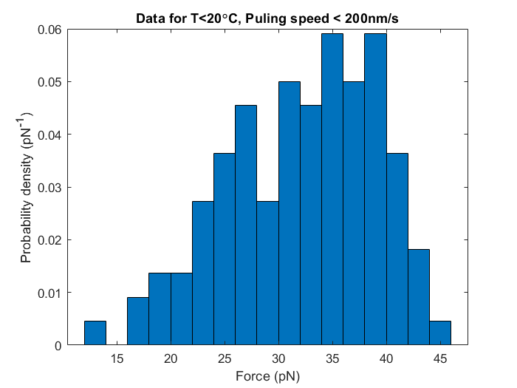
Prepare input (2)
Inspect the observed probability density:
F_list = (edges(1:end-1)+edges(2:end))/2; % force bin midpoints
figure; bar(F_list,pd_obs,1);
Data from Testfiles.zip in
https://github.com/are-mj/OpticalTweezers

Slide 25
Initial parameter guess
The optimisation function lsqcurvefit tries to find parameter values that minimise the difference between calculated and observe probability densities
The initial parameter vector tells lsqcurvefit where to start the search
Optimisation may be tricky:
The search may easily fail if initial values are far from the solution

Slide 26
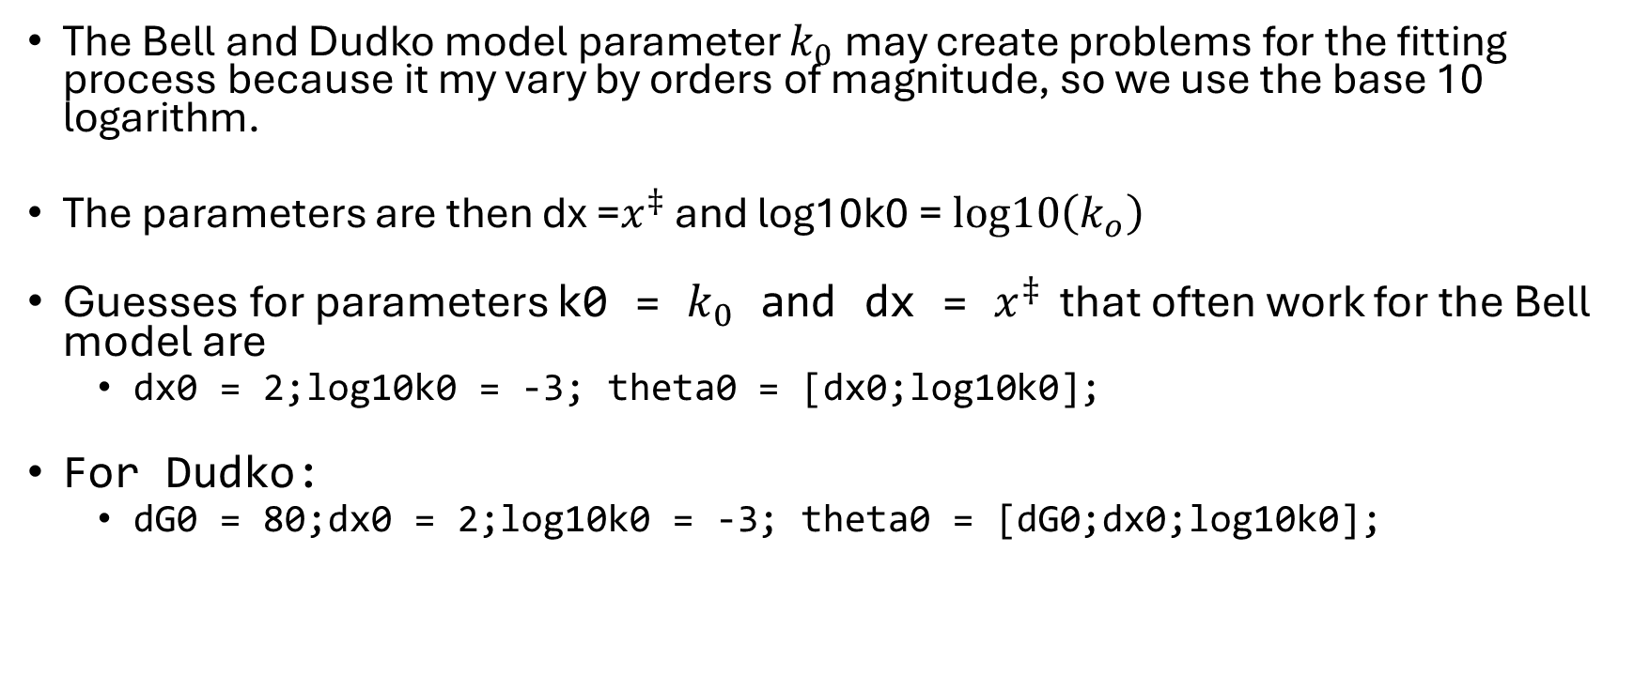
Initial parameter guess (2)
The Bell and Dudko model parameter $k_{0}$ may create problems for the fitting process because it my vary by orders of magnitude, so we use the base 10 logarithm.
The parameters are then dx =$x^{‡}$ and log10k0 = $log10\left(k_{o}\right)$
Guesses for parameters k0 = $k_{0}$ and dx = $x^{‡}$ that often work for the Bell model are
dx0 = 2;log10k0 = -3; theta0 = [dx0;log10k0];
For Dudko:
dG0 = 80;dx0 = 2;log10k0 = -3; theta0 = [dG0;dx0;log10k0];

Slide 27
Calculate best fit parameters
Function Bell_unfold_probability calculates the probability density distribution for a given parameter vector
Function fit_Bell_unfold calls this function repeatedly, searching for the parameter set that best fits the observed distribution;
[theta,theta_std] = fit_Bell_unfold(pd_obs,edges,Tmean,Fdotmean,theta0);
Print resulting parameters:
fprintf("x‡ = %.2fnm ± %.2g\n",theta(1),theta_std(1))
fprintf(“log10(k0) = %.2f ± %.2g\n",theta(2),theta_std(2))
x‡ = 1.40nm ± 0.068
lpg10(k0) = -1.92 ± 0.15

Slide 28
Inspecting the result
Create a set of 100 force values for the x axis:
F_plot = linspace(edges(1),edges(end));
Calculate and plot the probability density a:
pd = Bell_unfold_probability(theta,F_plot,Tmean,Fdotmean);
hold on; % To keep the bar graph
plot(F_plot,pd,'r','linewidth',2);
Add info to the plot:
xlabel("Force (pN)")
ylabel("Probability density (pN^-^1)")
title("Probability density for T>20\circC")
legend("Observed","Bell model","location","northwest")
\circ is LaTex for °

Slide 29
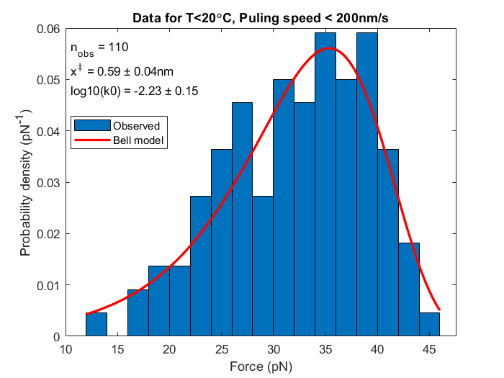
Inspecting the result
The curve is a good fit to the data
If initial parameter guesses are bad, the red curve is usually close to zero.
All the Matlab commands in the previous slides are collected in the file model_fitting_demo.m

Slide 30
Comparing Bell and Dudko

Slide 31
Units
Optical Tweezers experiments require some special units:
Length: 1nm = 10⁻⁹m
Force: 1pN = 10⁻¹²N
Energy per molecule: nm·pN = 10⁻²¹J = 1zJ (zettaJoule)
Avogadro constant: N_{A} = 6.02214 ×10²³ molecules/mol
Energy per mol: 1nm·pN · N_{A}= 602.214J/mol = 602.214 (J/mol) / 4184J/kcal = 0.1439 kcal/mol
Boltzmann constant: k_{B} = 1.381 J ×10⁻²³J/K = 0.01381 nm·pN /K

